Slide 1
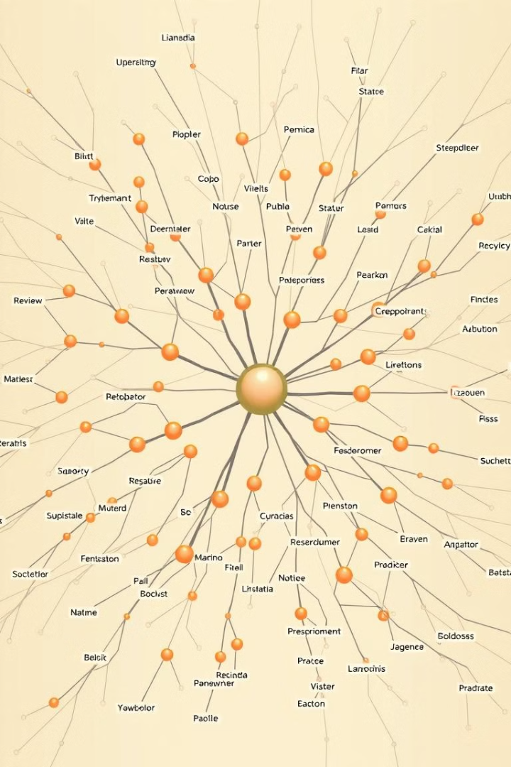
Understanding Large Language Models (LLMs) & ChatGPT
Demystifying the concepts behind Large Language Models and ChatGPT
Using visuals, and flow diagrams.

Slide 2
WHAT IS LLM..?
It is an AI system that can read, understand and generate Human like text.
Where it recognizes the pattern and predicts the words.
💡Example:
Imagine a super-smart parrot that has read millions of books and can talk like a human.
If you say, “Tell me a joke,” the parrot doesn’t have a specific joke memorized but knows the patterns of jokes and can make one up.
No Memorization.
Just Recognizing the patterns!

Slide 3
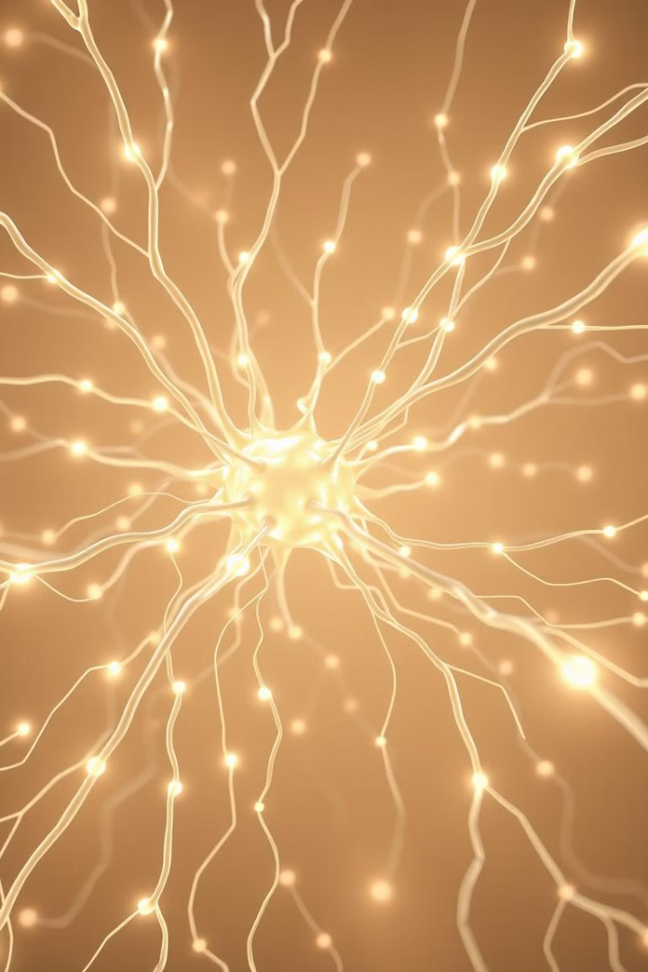
How LLMs Learn
1
Datasets
2
Tokenisation
An LLM learns from text written by humans—books, news articles, Wikipedia, and more.
Instead of reading full sentences, AI breaks them into tokens (small pieces of words).
💬 Sentence: “Artificial Intelligence is amazing!
Tokens: [ "Artificial", "Intelli", "gence", "is", "amaz", "ing", "!" ]
3
Embeddings
4
Transformers
Tokens are converted into numbers.
💬 "Happy" → [1.23, 4.56, 7.89]
💬 "Joyful" → [1.24, 4.57, 7.88]
💬 "Sad" → [5.67, 2.89, 3.45]
Happy & joyful are similar,
so they have closer numbers.
Remembering Important words and word relationships.
💬 Sentence: “I love apples, but oranges are tastier.”
💡 AI understands that “oranges” is linked to “tastier”, not “apples.”
This allows the AI to understand meaning and context rather than just memorizing words

Slide 4
Tokenisation..
Transformers..
Transformers are a type of AI model that can understand long texts while remembering important words and meanings from earlier sentences.
🔹 Byte-Pair Encoding (BPE):
AI Splitting Words Smartly.
AI doesn’t store a dictionary of all words!
Instead, it breaks words into common subwords to handle unknown words.
If AI has never seen the word “Unhappiness”, it breaks it into:
📌 "Un" + "happiness" → AI already knows "happy", so it understands this new word!
💡Example:
📌 Sentence: "The cat sat on the mat because it was tired.“
Old Models: “it” refers to what? (word by word)
New Models : “it” refers to cat! (Imp words)
New models can remember the context bcoz they use transformers.
And Transformers has a technique called Self Attention
Self-Attention is like highlighting the most important words in a sentence while reading.
💡Example:

Slide 5




Parameters & Learning
Parameters
1
Weights
LLMs have billions of parameters.
2
Weights are adjusted during training.
Learning
4
Backpropagation
3
LLMs learn from its errors.
Backpropagation is used for learning.

Slide 6

How ChatGPT generate responses
1
Prediction
2
Handling Context
ChatGPT does not search for answers—instead, it predicts the most likely next word!
💬 Example: "The sky is........“
🔹 AI considers:
"blue" (90% likely) ✅
"cloudy" (5%)
"dark" (3%)
Since "blue" is the most likely, it chooses that and moves on to predict the next word!
ChatGPT remembers recent messages within a context window but forgets old messages.
🔹 Example:
👤 "Who discovered gravity? Isaac Newton.“
👤 "When did he live? He lived from 1643 to 1727.“
ChatGPT remembers "Isaac Newton" was the topic but forgets this if the chat is too long.
Fact:
3
Parameter adjustment
Parameters are like settings on a camera that adjust how the AI processes text.
A camera has settings like brightness, contrast, and focus,
changing these settings changes how the picture looks.
Similarly, ChatGPT has billions of parameters that fine-tune its responses.

Slide 7
What happens when you ask a question to ChatGPT?
Input
1
Suppose you typed, “What is AI”.
2
Tokenization
Converts into [ "What", "is", "AI", "?" ]
Embeddings
3
Transforms words into numbers
4
Self Attention
Finds important words
Predict Next Words
5
AI calculates probabilities and generates the response,
Based on weights
6
Final Output
"AI stands for Artificial Intelligence,
which is a technology..."

Slide 8
Challenges and limitations
Bias in Responses:
AI learns from human data, so it inherits human biases from books and the internet.
🔹 Example: If AI is trained more on Western history, it might not know much about smaller cultures.
2. Hallucinations (Making Up Facts):
AI sometimes guesses answers incorrectly rather than saying “I don’t know.”
🔹 Example: If asked, “Who won the 2025 World Cup?”
ChatGPT might make up a name since its training data stops at 2024.
3. No True Understanding:
AI predicts words but doesn’t think like humans.
🔹 Example: If you ask, “What does sadness feel like?” AI can describe it but doesn’t actually feel emotions.

Slide 9

Present & Future of LLMs
Real-World Applications
✅ Customer Support – AI chatbots for FAQs, complaints, troubleshooting. ✅ Education & Tutoring – AI explains concepts, assists with learning. ✅ Content Creation – Automates writing, social media, marketing. ✅ Programming Assistance – Debugging, code suggestions (GitHub Copilot). ✅ Healthcare – AI in diagnostics, reports, research. (Domain specific) ✅ Legal & Documentation – Drafting contracts, legal analysis. ✅ Search & Information Retrieval – Smarter AI-powered search. ✅ Personal Assistants – AI for reminders, emails, scheduling. ✅ Creative Fields – AI-generated art, music, storytelling.
Future Possibilities
🚀 More Personalized AI – Adapts to user preferences. 🧠 Smarter & More Context-Aware AI – Better understanding of tone/emotion. 🔍 More Accurate & Reliable AI – Less bias, better fact-checking. 🤖 AI in Robotics & Automation – AI-powered robots in daily tasks. 🌎 AI for Social Good – Disaster prediction, environmental protection.

Slide 10
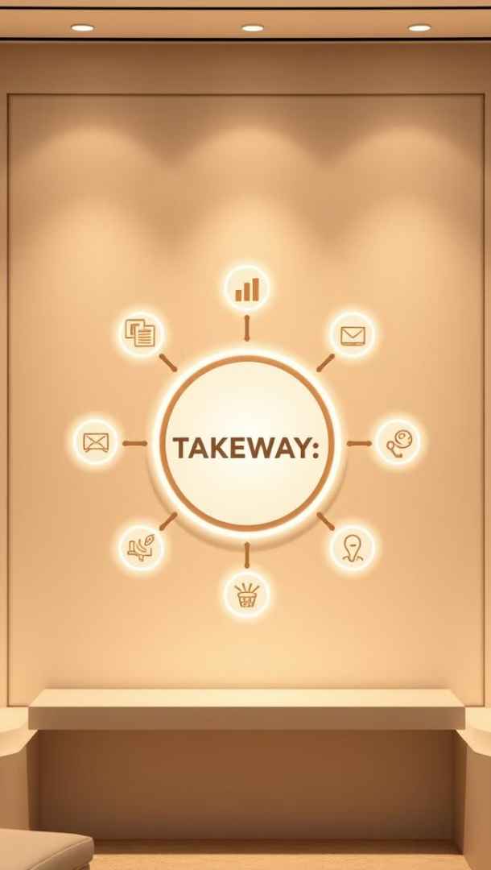
Key Takeaways
How it Learns..
Response generation
Datasets
Tokenisation
Embeddings
Transformers
Backpropogation
Input
Prediction
Context handling
Parameter Adjustment
Convert & output
Limitations of LLMs
Future Possibilities

